Slide 1
Building a Modern Skillset for Free

Slide 2

Aaron Martin
Aaron is a Security Architect for High Wire Networks. Aaron's career began in development and transitioned to Ops/DevOps followed by Security. Now he helps lead a R&D/Product Development team where his hands are in all three fields.

Slide 3
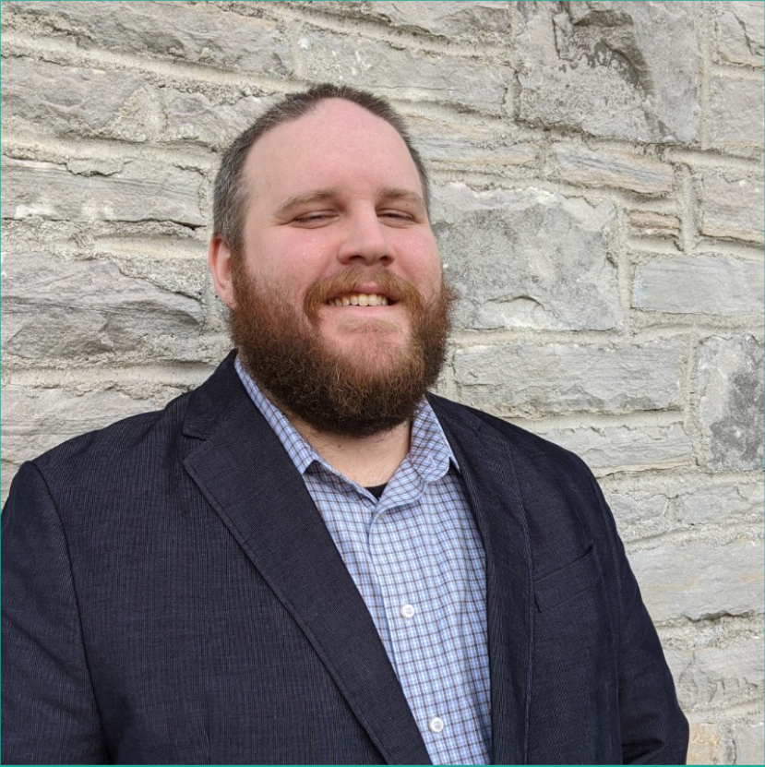
Nickolas Strong
I am a former over the road truck driver who made a career change into cybersecurity. Currently I work as a Cloud Security Automation Administrator for Ncontracts. I also works to help students in career transitions as a Teaching Assistant for the Vanderbilt University Cybersecurity boot camp and for the NSS GOTech program.

Slide 4
Who is this for?
Beginners just starting out!
Students looking to learn more!
Career veterans looking to brush up on new skills!

Slide 5
Why are we doing this?
Showcase to others that anyone can learn these new skills.
Show how it is relatively free to pick up these modern skills.
Show off how it’s easily accessible and that there’s plenty of free source material to get started.

Slide 6
How does this benefit you?
Gain an understanding of several methodologies; Cloud, DevOps, Security
Acquire new skills to add to your resume.
Hands on familiarity with Azure, Docker, Terraform and Azure Sentinel.
Using DVWA (Damn Vulnerable Web App) get familiarity with penetration testing.
Follow that up with Azure Sentinel to get an understanding of detection and response through log analysis!
Gain some experience and have fun!

Slide 7
Why Cloud Labs? Pros VS Cons
Pros:
Easily accessible
Free with $200 free trial(Azure)
No physical hardware required for infrastructure
Low cost after trial
Easy to build infrastructure
Easy to learn
Cons:
Surprise costs can happen.
Monthly cost after free trial.
Not all services are created equal in terms of $$$. (Firewall, Network Gateways, DDOS Protection are some services that can accumulate cost quickly.)

Slide 8
Tools of the Trade
Azure/Azure Sentinel
Docker
Terraform
Damn Vulnerable Web App

Slide 9
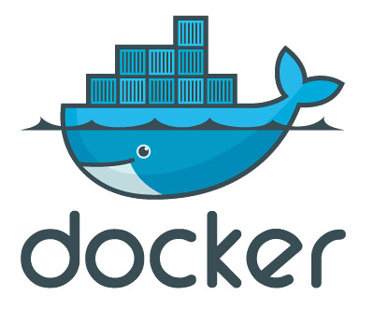
Docker
Docker is a tool designed to make it easier to create, deploy, and run applications by using containers. Containers allow a developer to package up an application with all of the parts it needs, such as libraries and other dependencies, and ship it all out as one package.

Slide 10

Azure/Azure Sentinel
Azure is a public cloud computing platform. Offering services such as Infrastructure, Platform, and Software as a Service. Azure can be used for analytics, virtual computing, storage, networking, security, and much more.
Azure Sentinel is a native log analytics/SIEM (Security Information and Event Management) system. This allows to search all of your logs for app errors or security detections, plus much more.

Slide 11

Terraform
Terraform is an open source, CLI-based infrastructure as code tool created by Hashicorp. Terraform is cloud agnostic meaning it will work with Cloud providers like Azure, AWS, GCP, etc. Terraform allows you codify your infrastructure, meaning if you want to build a virtual machine in Azure, you can write a Terraform script to do so without ever having to login to the Azure Portal.

Slide 12

Damn Vulnerable Web App
Damn Vulnerable Web Application (DVWA) is a PHP/MySQL web application that is damn vulnerable. Its main goal is to be an aid for security professionals to test their skills and tools in a legal environment, help web developers better understand the processes of securing web applications and to aid both students & teachers to learn about web application security in a controlled class room environment.

Slide 13
Implementation

Slide 14
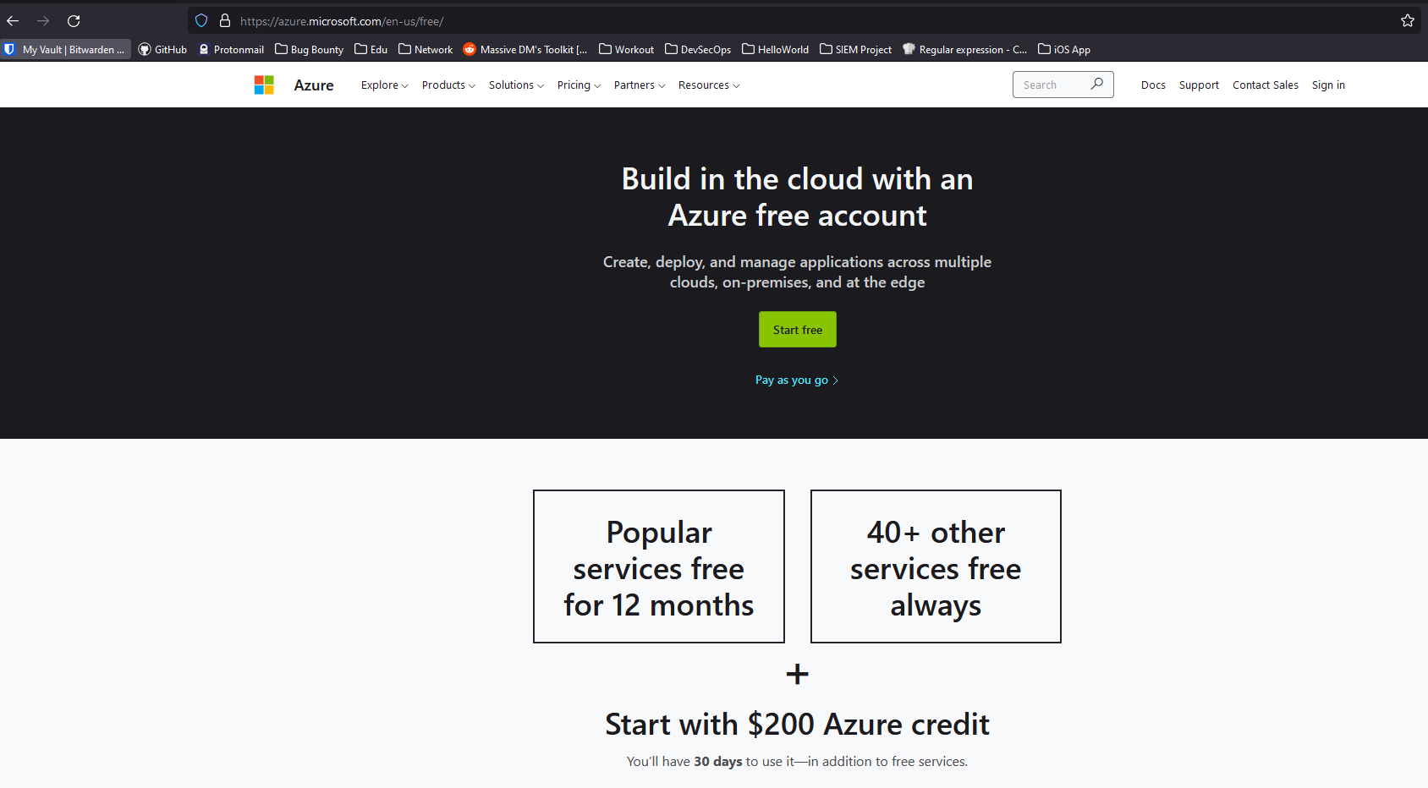
Let’s get started!
https://azure.microsoft.com/en-us/free/
Click Start Free link

Slide 15
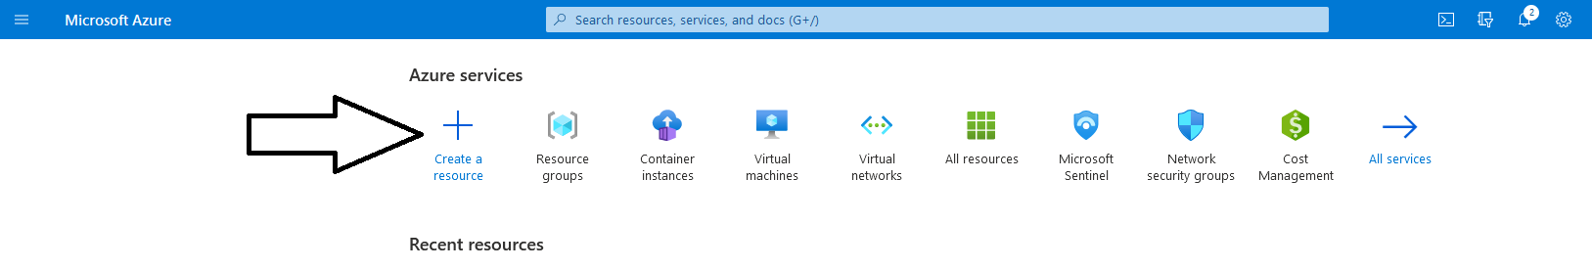
Create your resources!
Create your first resource!
Creating a Resource Group!

Slide 16
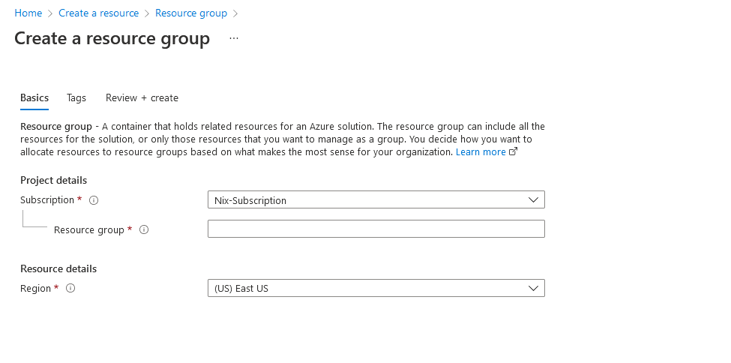
Your Resource Group
Find and Create a Resource Group!
Choose your subscription and Name your Resource Group!

Slide 17
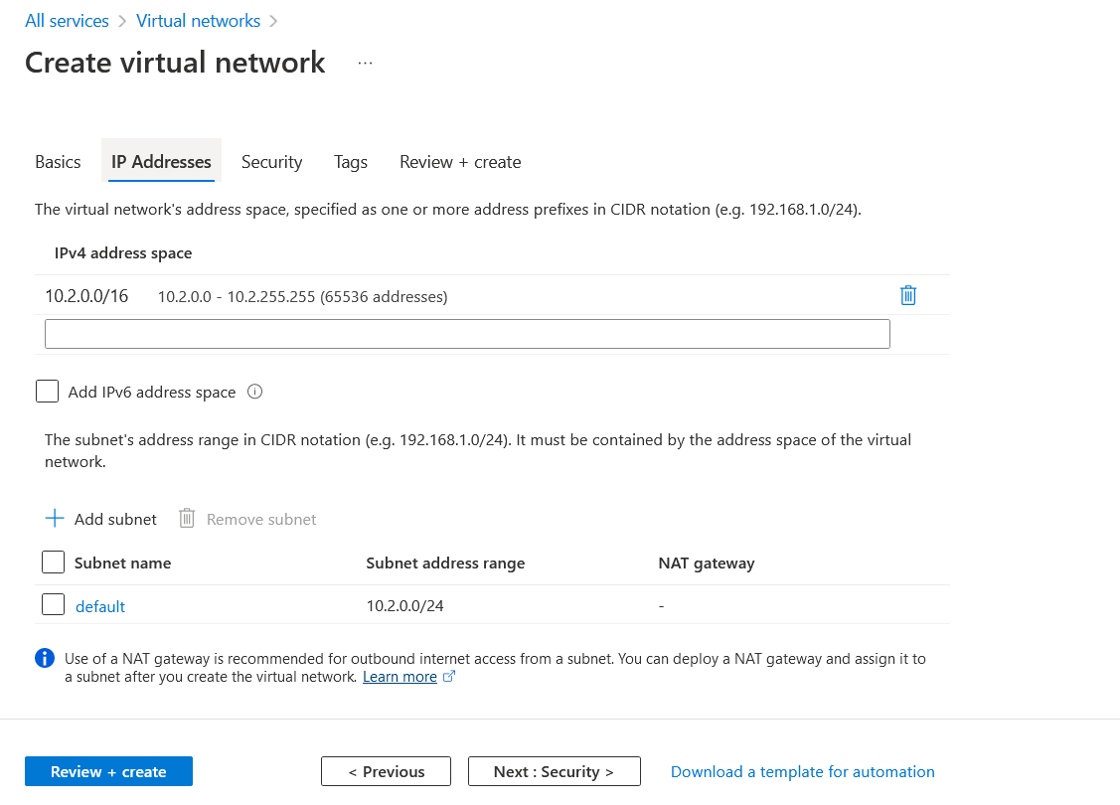
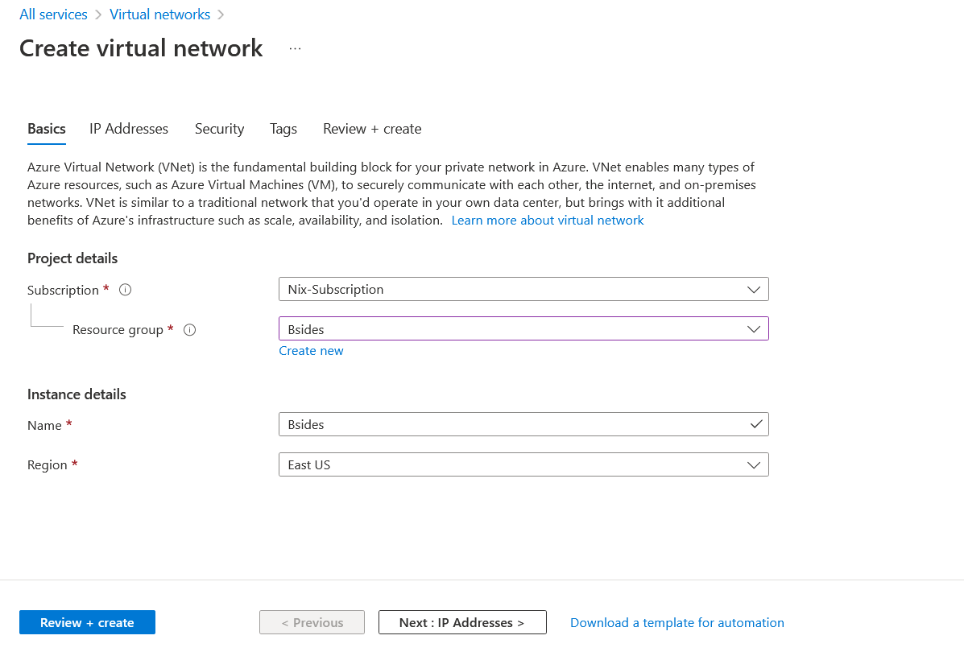
Your First VNET!
Walk through the Guided Steps on setting up your first VNET and Subnet!

Slide 18
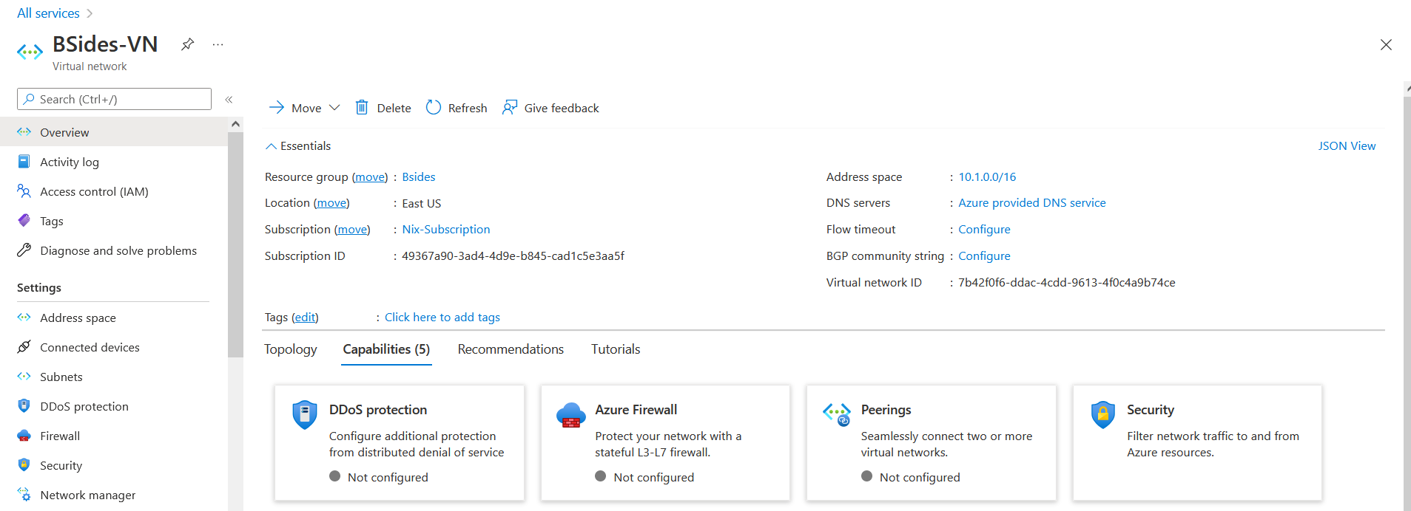
VNET Finished

Slide 19
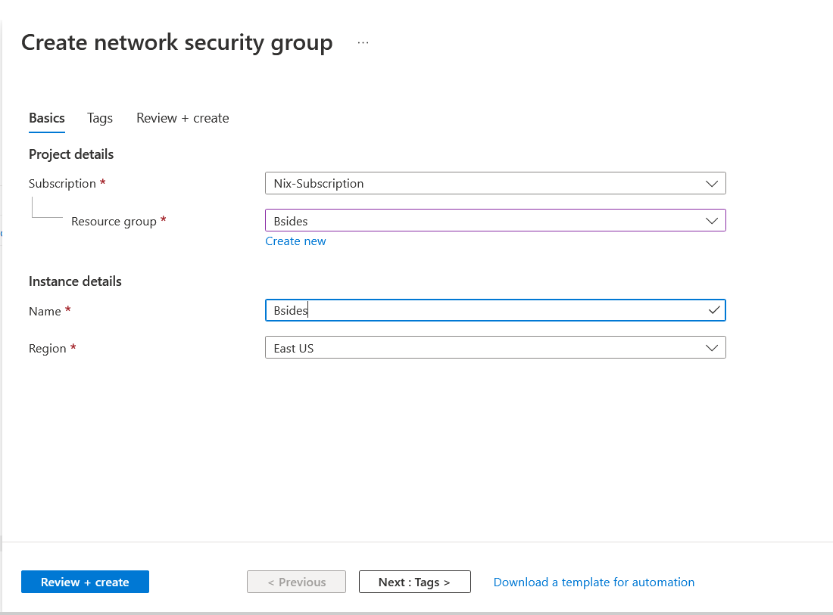
Let’s create a NSG!
Create your first Network Security Group
NSG’s over Azure Firewall

Slide 20
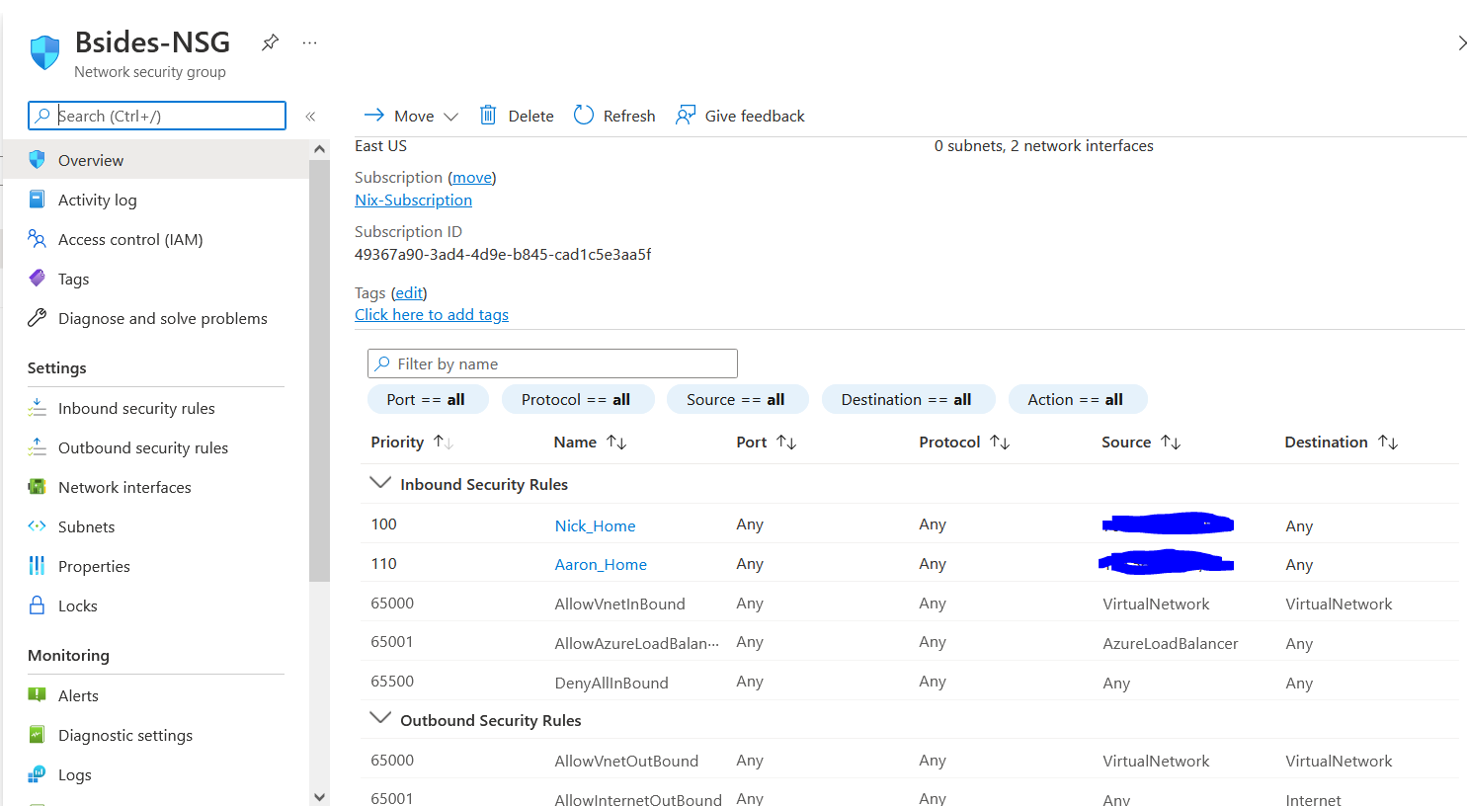
NSG Here We Come
Let’s Create an Inbound Security Rule to allow your home Public IP to touch resources!
Move this rule to the top.
Move the Deny All Inbound rule directly below this one!

Slide 21
Let’s Create our VMs!
Choose your Resource Group
Name it
Select your region
Find what OS you want
And choose the size of the VM!
Choose Whatever Storage Size you want
And make sure to set your VNET and add a Public IP!

Slide 22
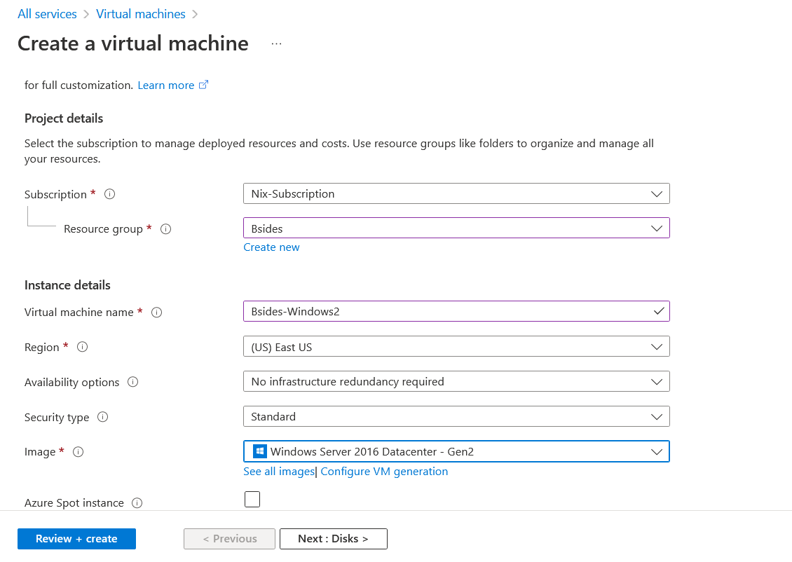
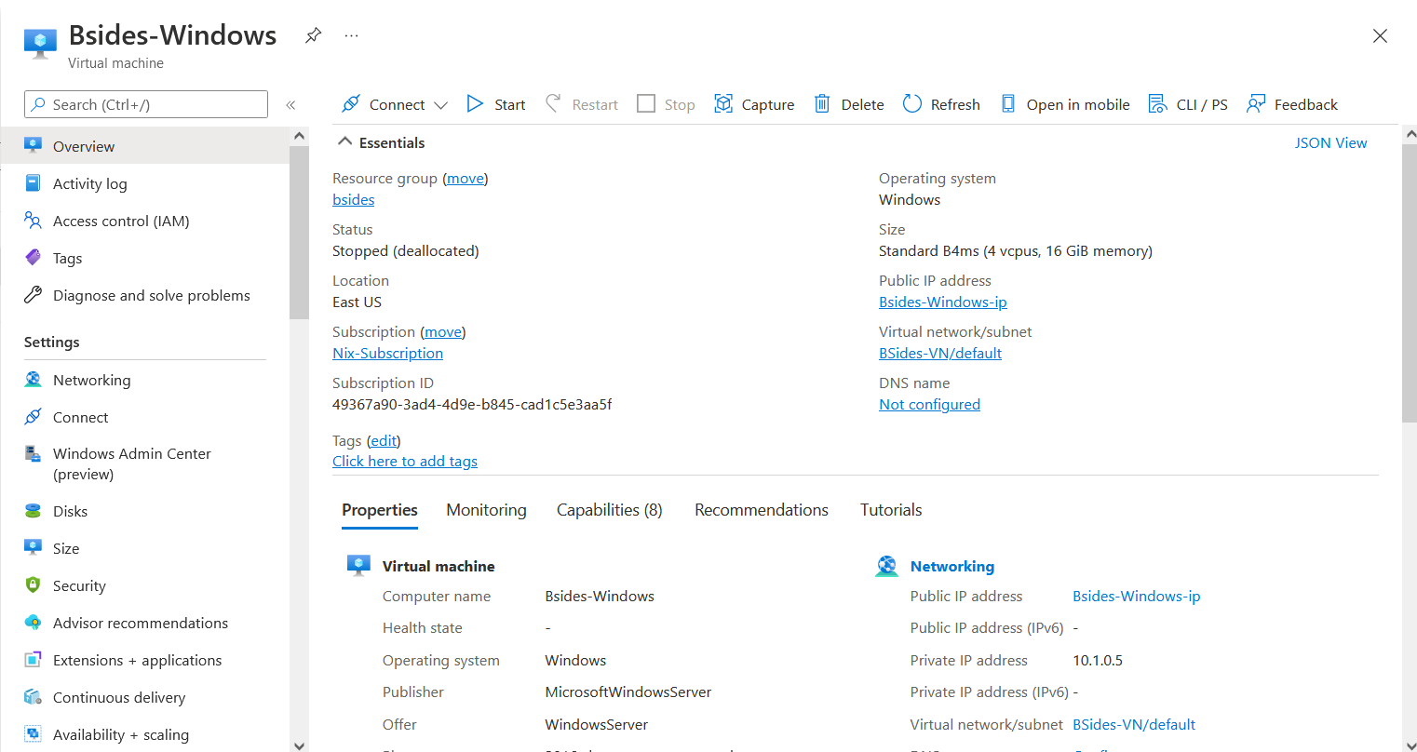
Windows VM

Slide 23
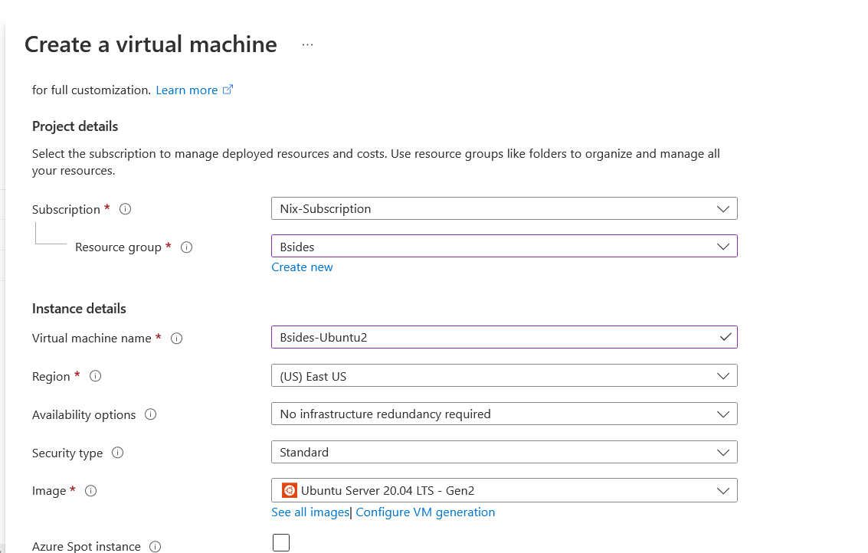
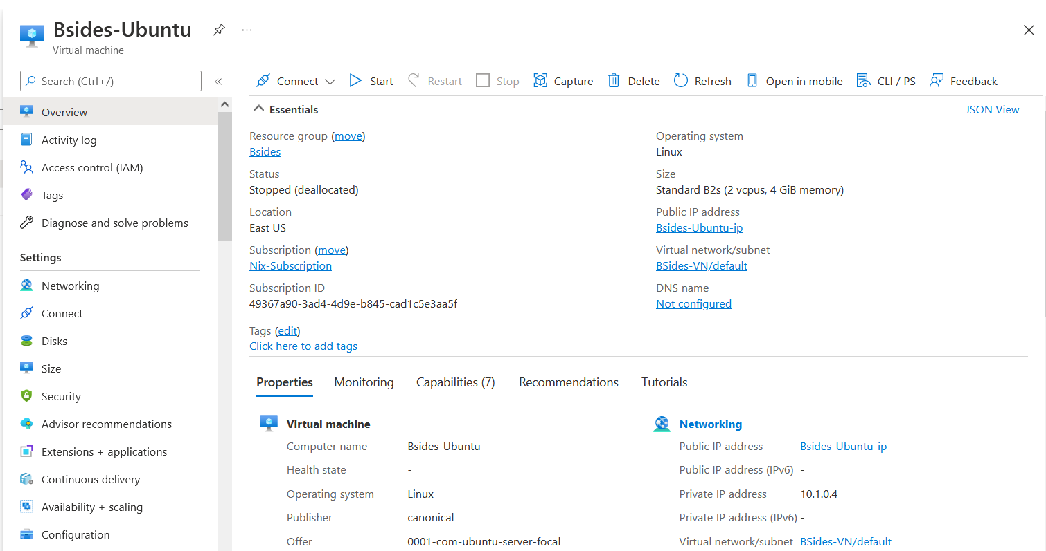
Ubuntu VM

Slide 24
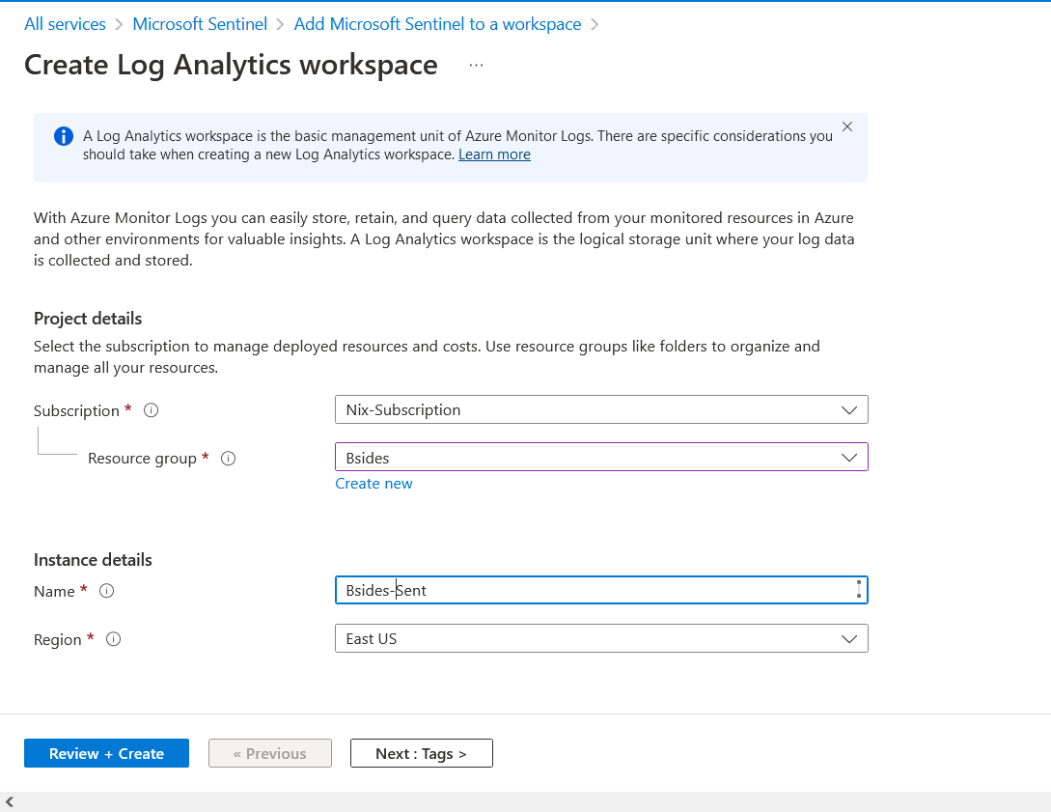
Log Analytics & Azure Sentinel
Let’s create our Log Analytics and Azure instance before we create our Container Instance!
You’ll need the Workspace ID & Key before you build the Container Instance!

Slide 25
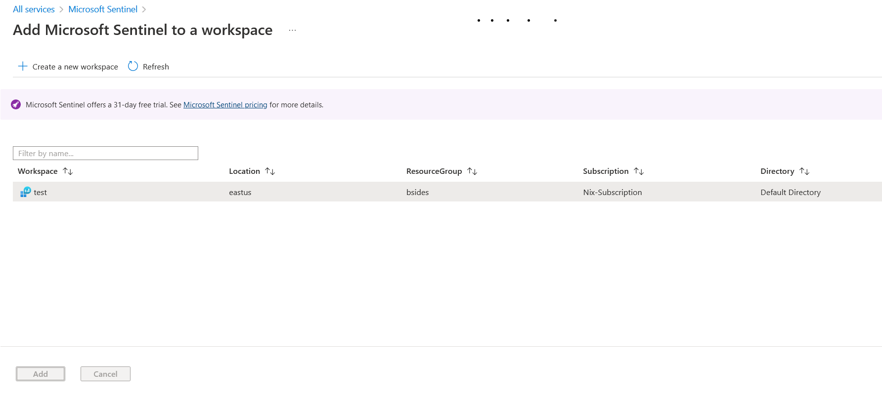
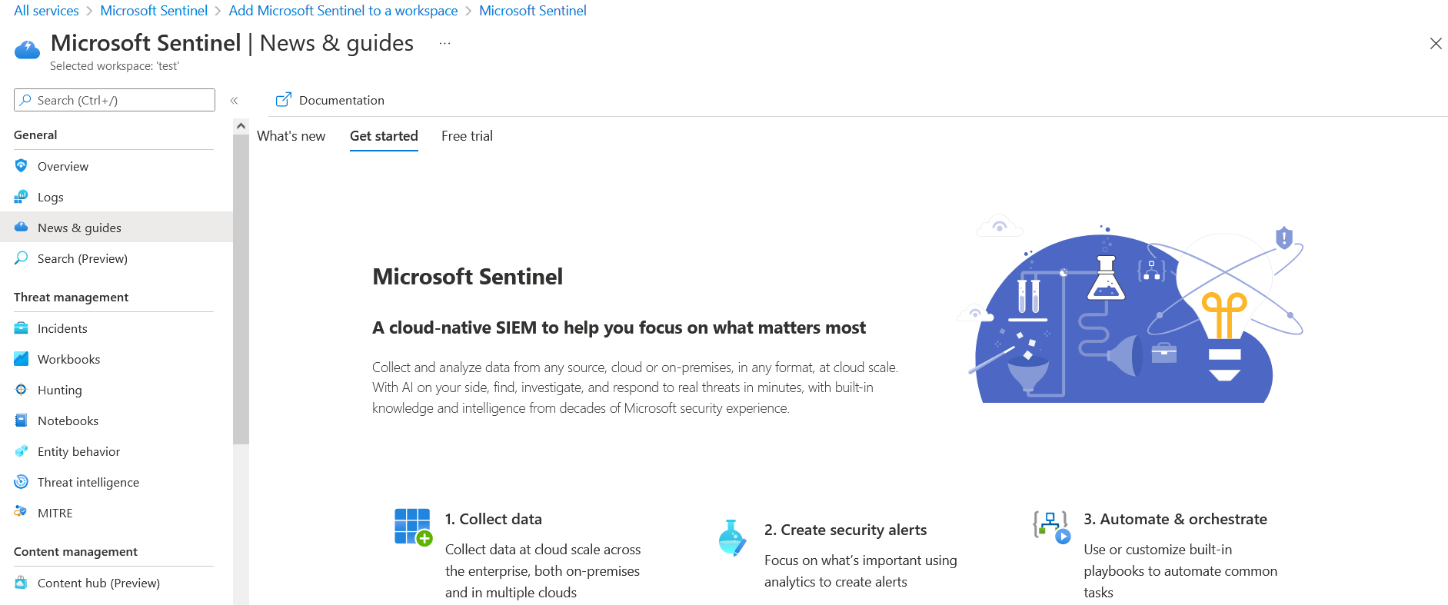
Next up Azure Sentinel!

Slide 26
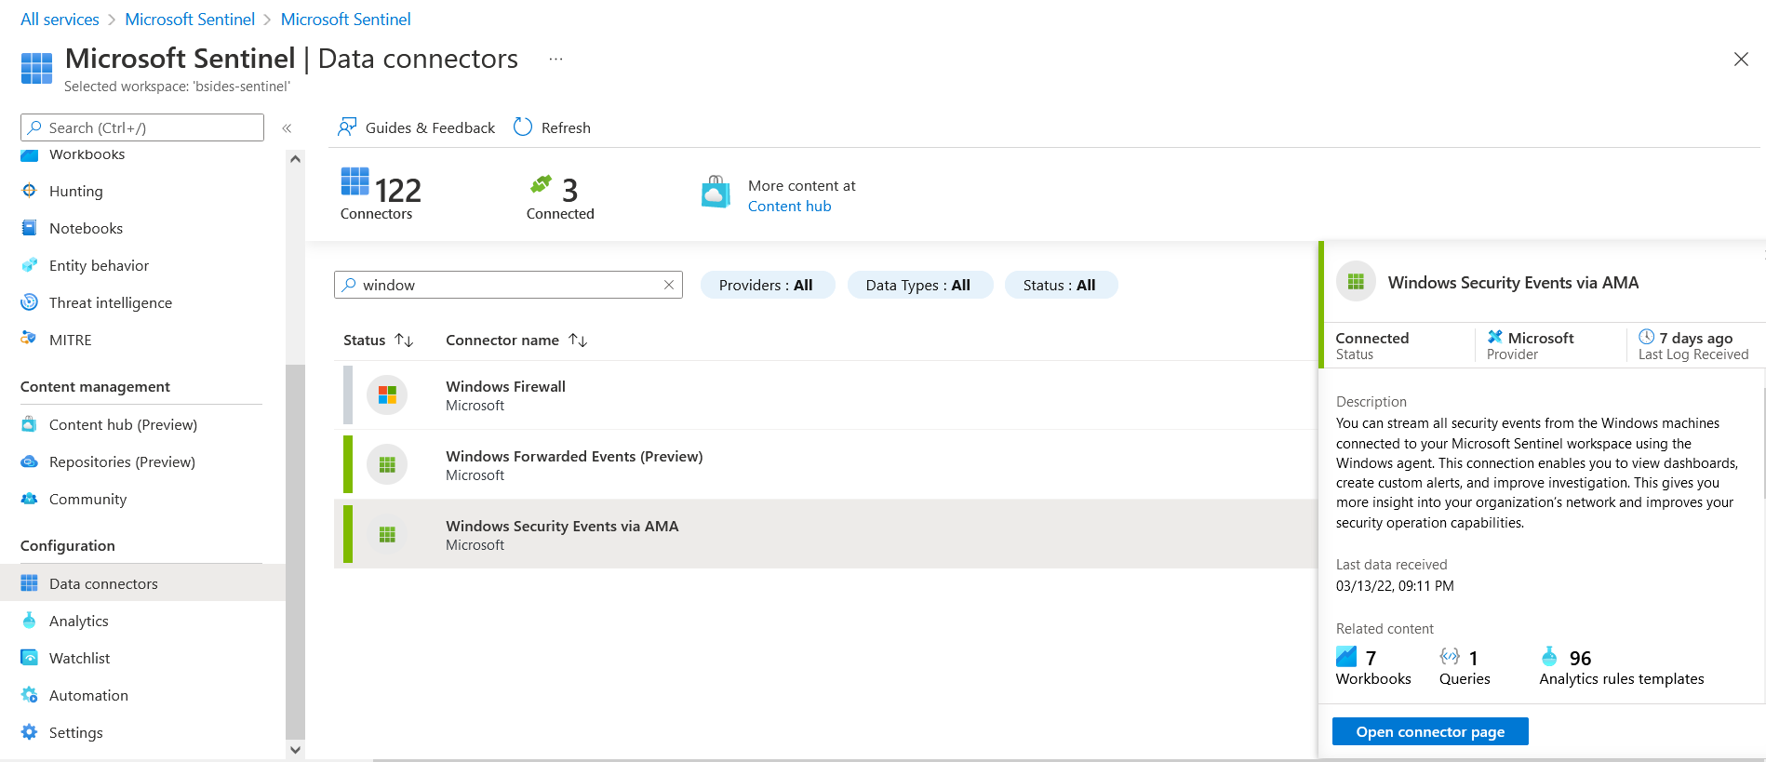
Nom Nom Logs
Let’s work on setting up some logging and then we’ll circle back to the container instance!
Let’s search for our Windows Security Events via AMA connector!

Slide 27
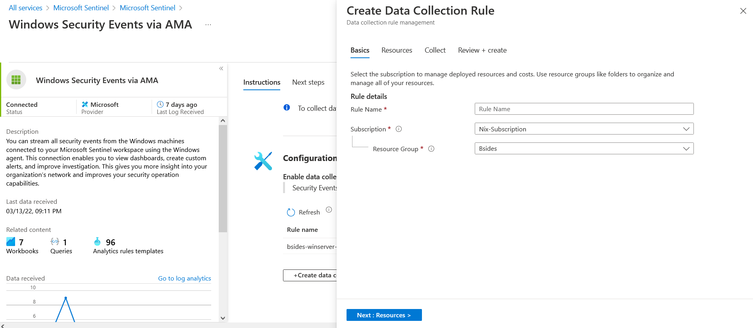
LOOOOOGS
Walk through the guided setup on how to setup your Windows AMA Agents!

Slide 28
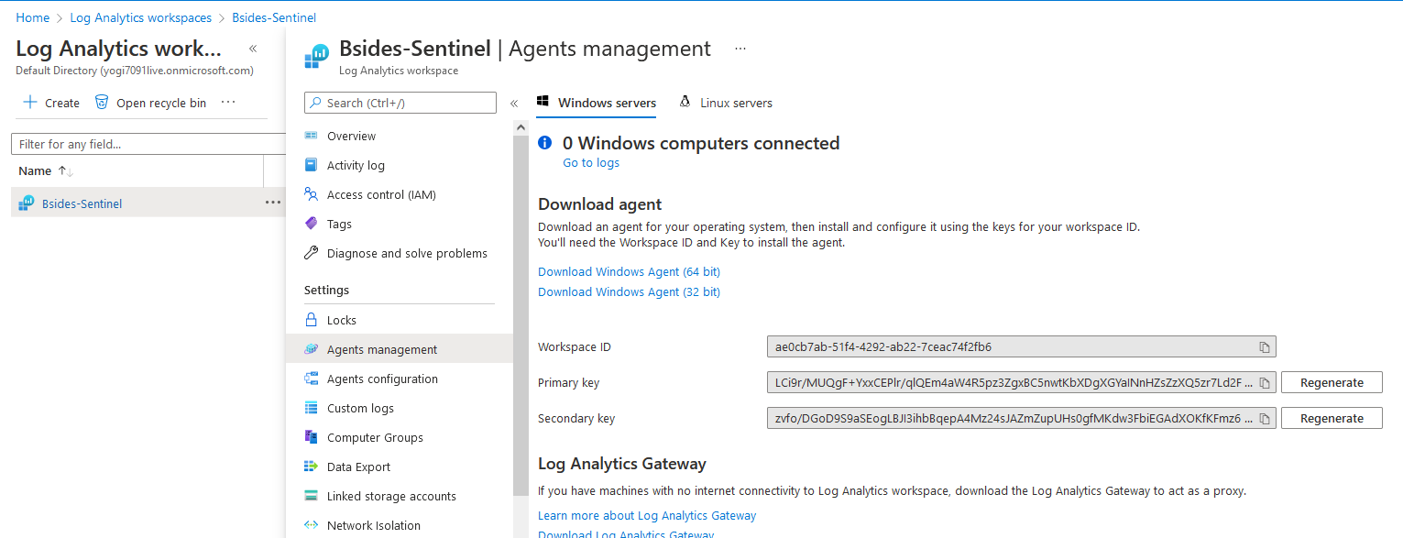
Container Time!
Before we setup the Container Instance of DVWA, we need to first document our Workspace ID and Key!
Travel back over to your log analytics workspace, and find the Agents Management tab!

Slide 29
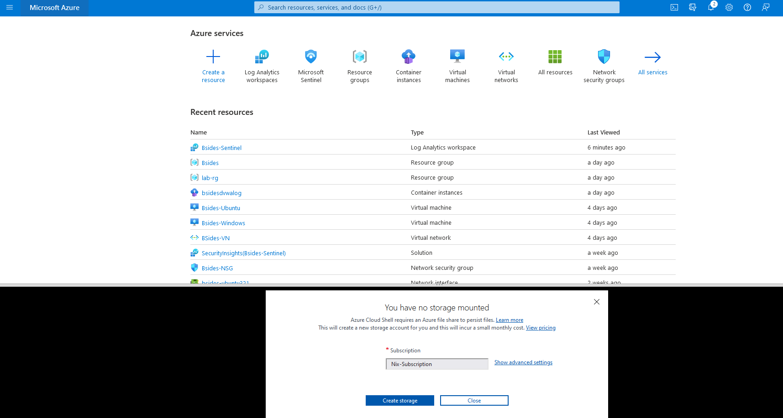
Containers and Azure CLI
Now let’s set up our Container Instance, but we’ll need the Azure CLI with a Bash Shell to do this!
The quickest way to do this is from the Azure Gui!
Click the first icon next to the search bar!
Create storage and choose Bash!

Slide 30
Container Commands!
Now that we have our CLI up and running we’re going to run the command to our right!
This command establishes that we’re creating a container, choosing our resource group, our name, where the image lives, what IP type, Port number, and our Log Analytics Key&ID
az container create \
--resource-group Bsides \
--name bsidesdvwalog \
--image vulnerables/web-dvwa \
--ip-address Public \
--ports 80 \
--log-analytics-workspace
--log-analytics-workspace-key

Slide 31
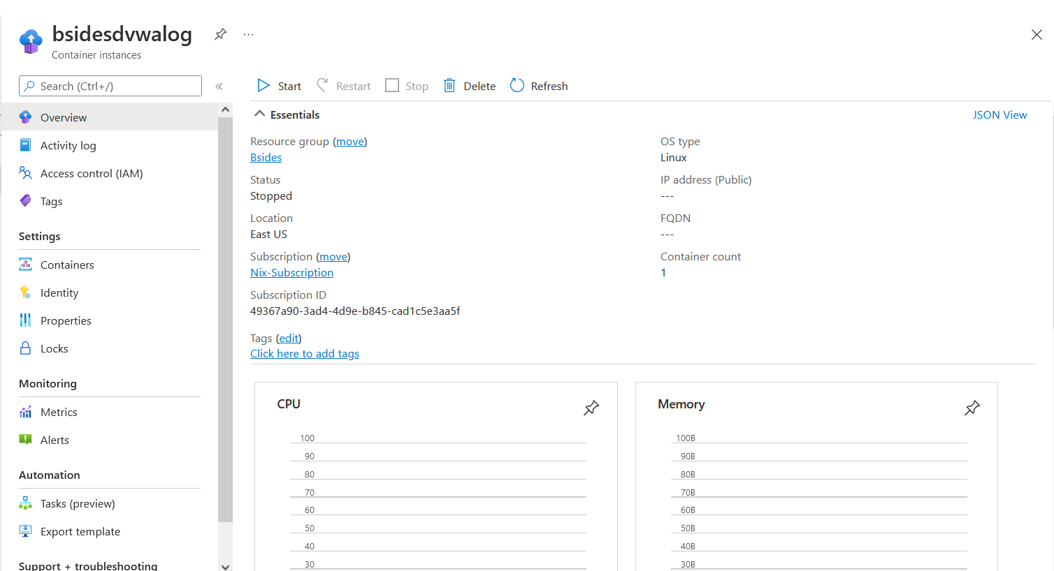
Ta-Da! Our New Container!
Search for Container Instances and view your newly running Damn Vulnerable Web App docker container!

Slide 32
How to use your new lab for Security.

Slide 33
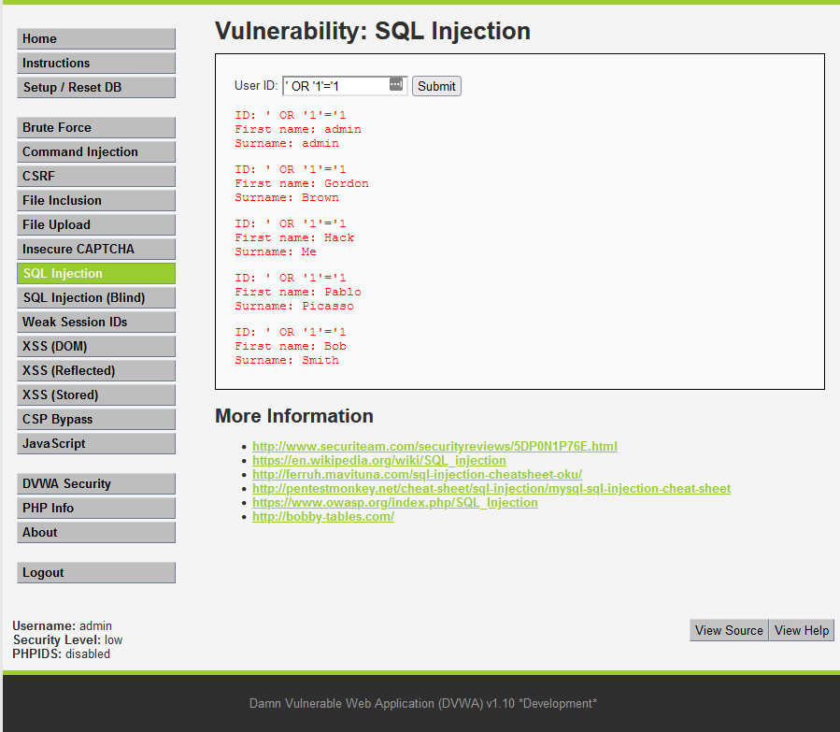
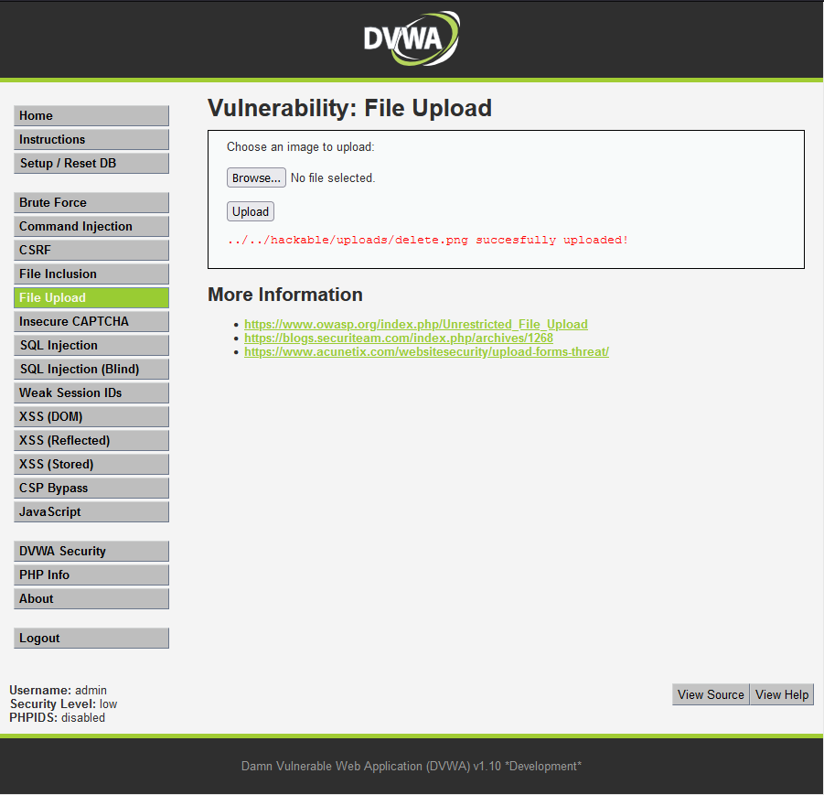
Attack the machines!

Slide 34
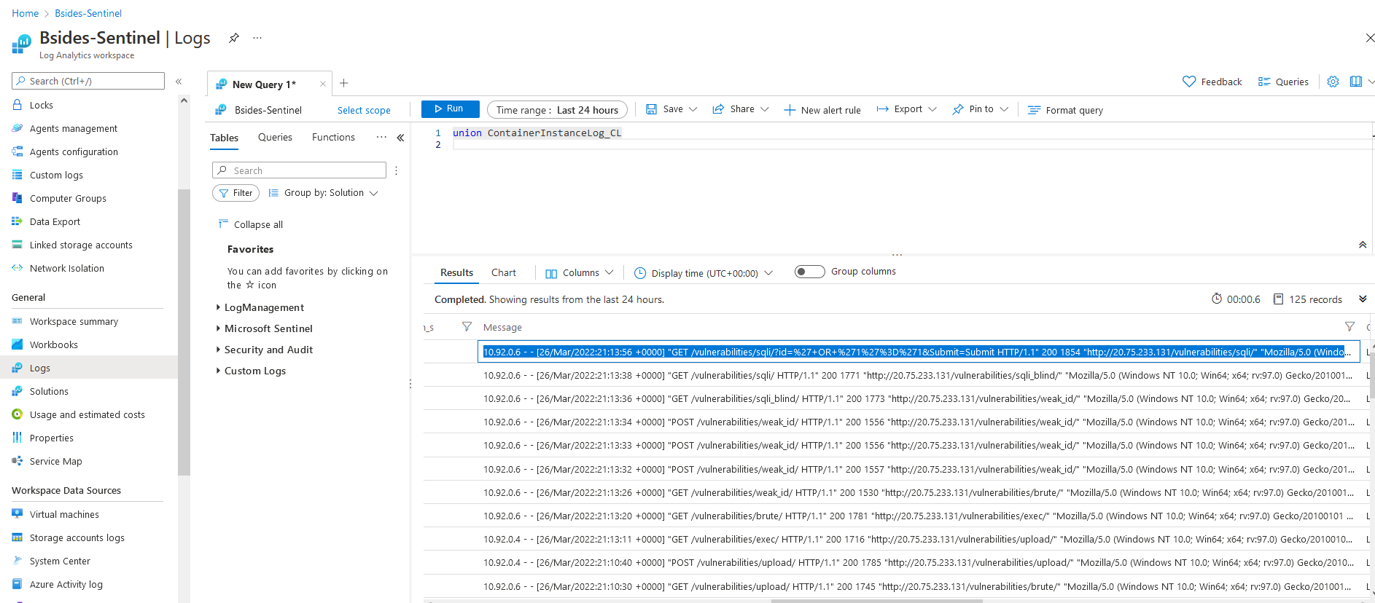
Hunting the bad guys! (Aka us….)

Slide 35
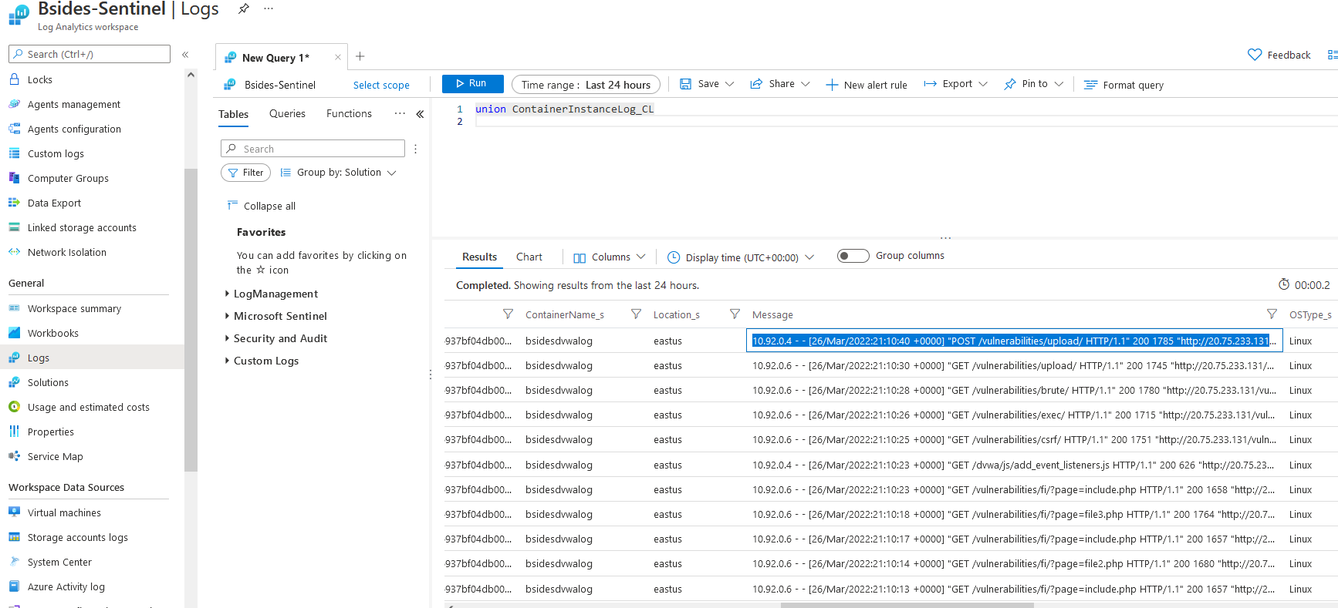
Still hunting!

Slide 36
How to utilize and build with Terraform

Slide 37
Installing Terraform for Azure CLI
Guess what….? It already is installed! Wasn’t that easy? By default Azure CLI comes with Terraform installed.

Slide 38
Creating the Terraform Configuration file
First you will need to create a directory dedicated to your Terraform scripts. This folder is typically named after a module, in this case Terraform is fine for testing.
Next you will create a file within this directory that is the config file. This file will use the .tf file extension. You can name this whatever you like for our file we went with lab.tf for ours.
Online you will find many examples of the syntax known as Terraform HashiCorp configuration language. This language and optionally JSON is used to instruct Terraform what resources to create within Azure.

Slide 39
Initialize - Test - Apply!
Terraform out the box will not know what kind of providers you are using. It's really simple and easy to do this from within the folder you created earlier for Terraform run the command: ps> terraform init After you have initialized the directory and created the config file its time to test first! Run the following command: ps> terraform plan
Now after you don't see any errors for the apply command. Its time to execute the Terraform automation. Run the following command to produce your resources in Azure: ps> terraform apply

Slide 40
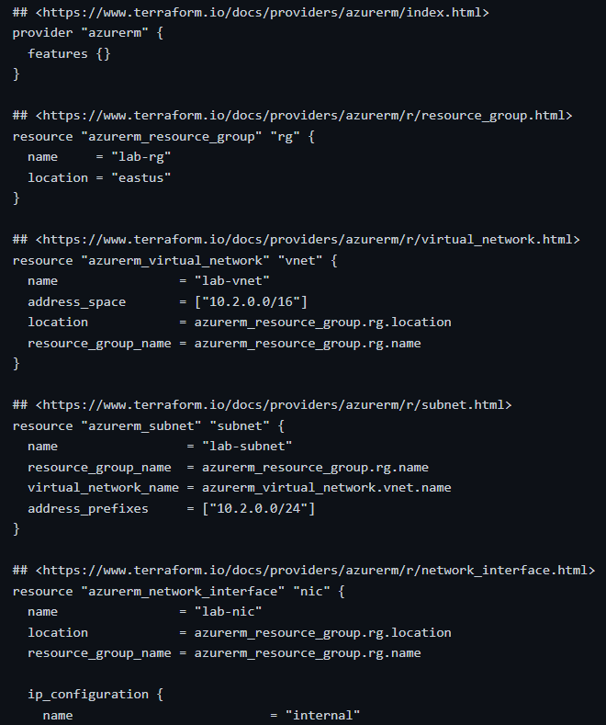

Slide 41

DEMO TIME

Slide 42
Aaron’s Contact Info:
Linkedin - www.linkedin.com/in/aaron-martin13
Twitter - @0ne_4_All
Nick’s Contact Info:
Linkedin - https://www.linkedin.com/in/nickolasstrong/
GitHub Repo -
https://github.com/HelloWorldTech123/Bsides

Slide 43
Resources:
https://docs.microsoft.com/en-us/azure/developer/terraform/overview
https://learn.hashicorp.com/collections/terraform/azure-get-started
https://docs.microsoft.com/en-us/azure/sentinel/tutorial-respond-threats-playbook#respond-to-incidents
https://m365internals.com/2021/07/05/why-are-windows-defender-av-logs-so-important-and-how-to-monitor-them-with-azure-sentinel/
https://charbelnemnom.com/missing-required-playbook-triggering-permissions/

Slide 44
More Resources:
https://docs.microsoft.com/en-us/azure/sentinel/create-incidents-from-alerts
https://techcommunity.microsoft.com/t5/microsoft-defender-for-cloud/how-to-isolate-an-azure-vm-using-azure-security-center-s/ba-p/1250985
https://docs.microsoft.com/en-us/learn/paths/az-900-describe-cloud-concepts/
https://docs.microsoft.com/en-us/azure/sentinel/quickstart-onboard

Slide 45
THANK YOU!

